Slide 1


Slide 2


Slide 3


Slide 4
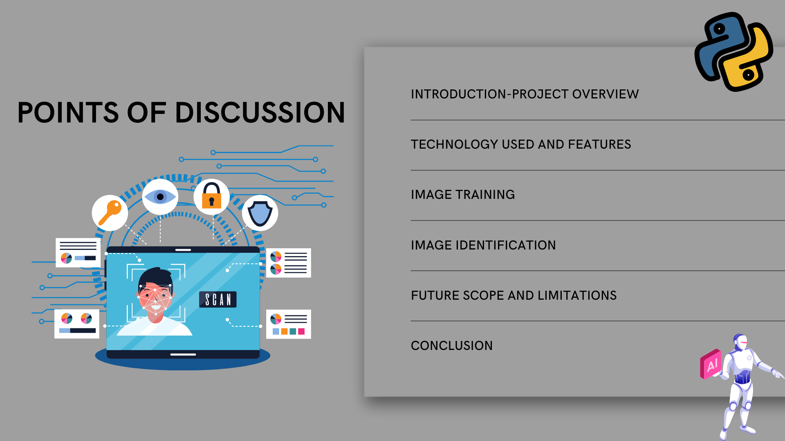

Slide 5
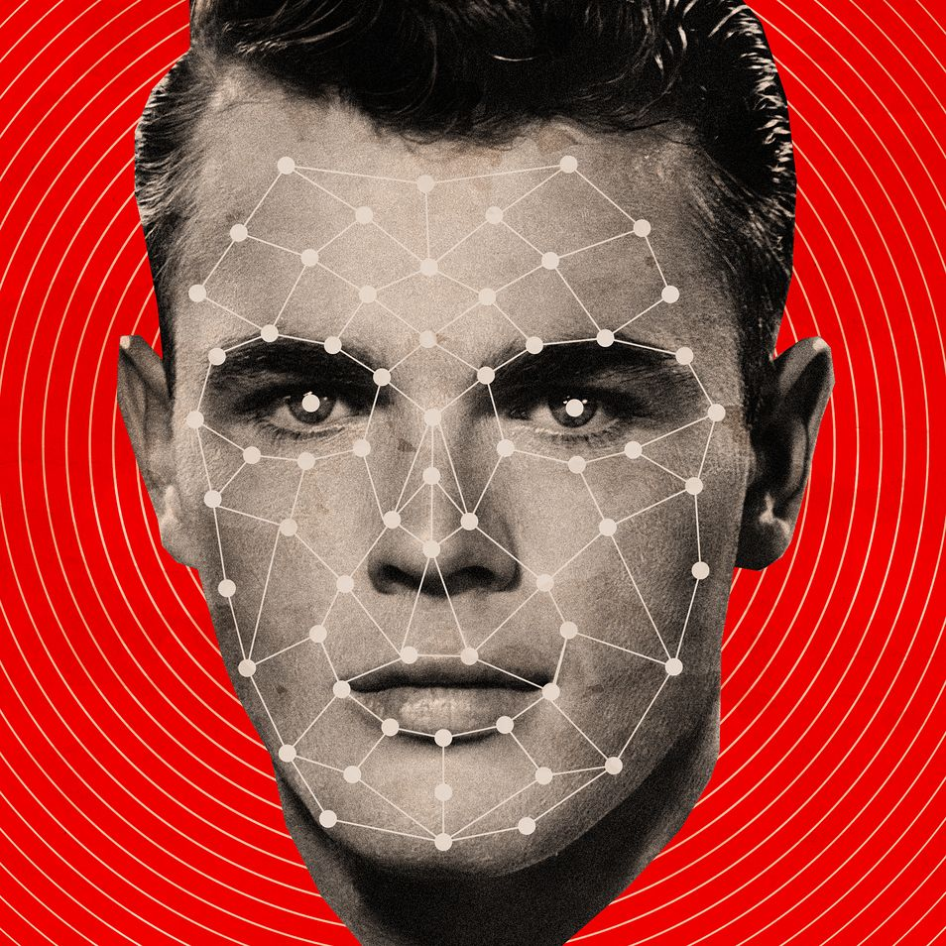
INTRODUCTION
It is basically a python GUI integrated attendance system using face recognition to take attendance.
In this python project, We have made an attendance system which takes attendance by using face recognition technique.
This Photo by Unknown Author is licensed under CC BY

Slide 6
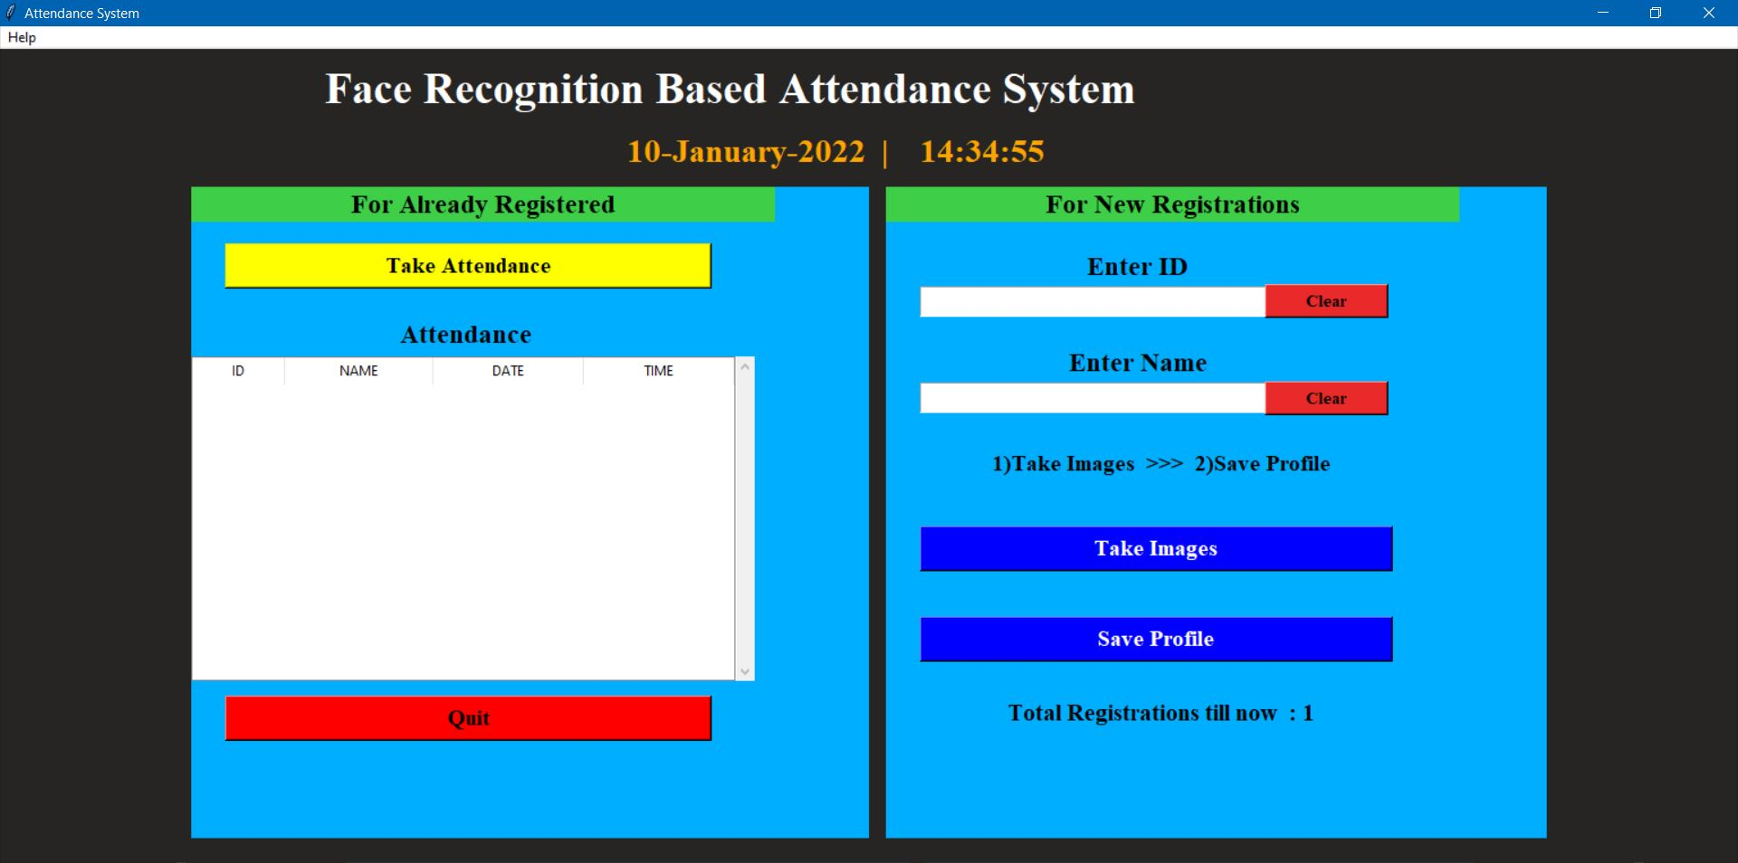
Project Overview

Slide 7


TECHNOLOGY USED
tkinter for whole GUI
OpenCV for taking images and face recognition (cv2.face.LBPHFaceRecognizer_create())
CSV, Numpy, Pandas, datetime etc. for other purposes.

Slide 8


FEATURES
Easy to use with interactive GUI support.
Password protection for new person registration.
Creates/Updates CSV file for details of students on registration.
Creates a new CSV file everyday for attendance and marks attendance with proper date and time.
Displays live attendance updates for the day on the main screen in tabular format with Id, name, date and time.

Slide 9
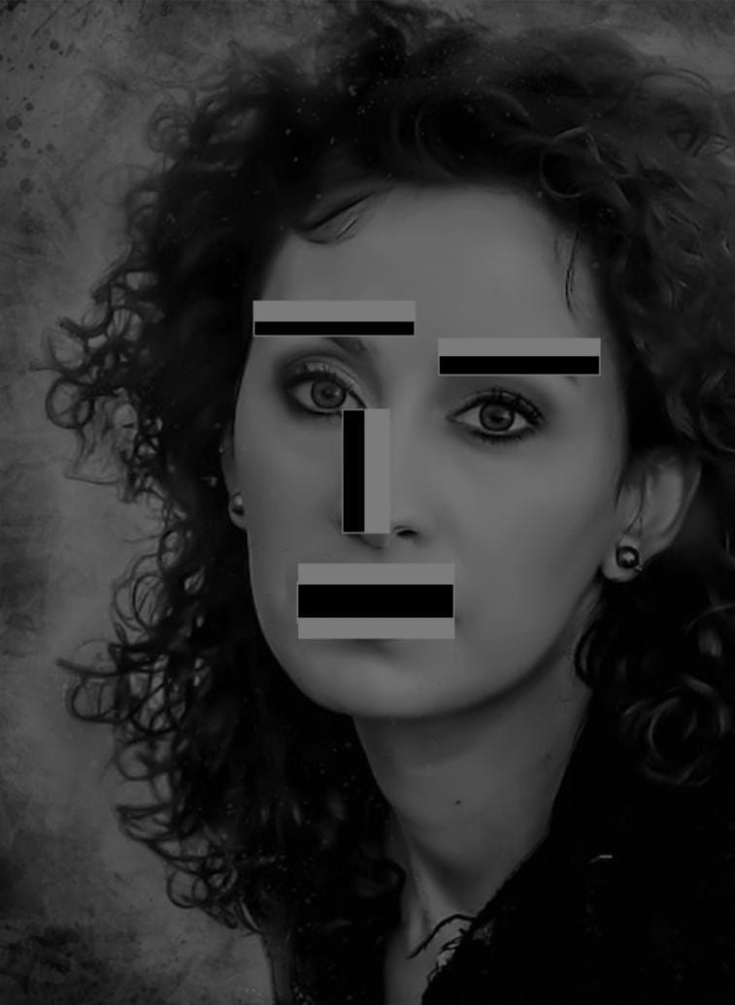
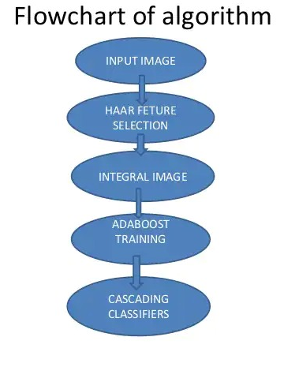
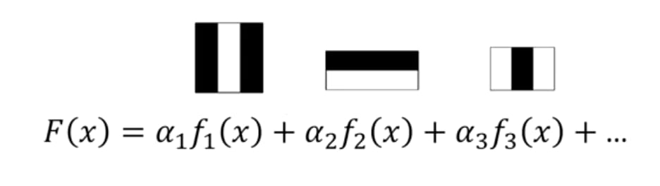
TRAINING OF IMAGES USING HAAR CASCADE CLASSIFIER ALGORITHM
It is an Object Detection Algorithm used to identify faces in an image or a real time video.

Slide 10
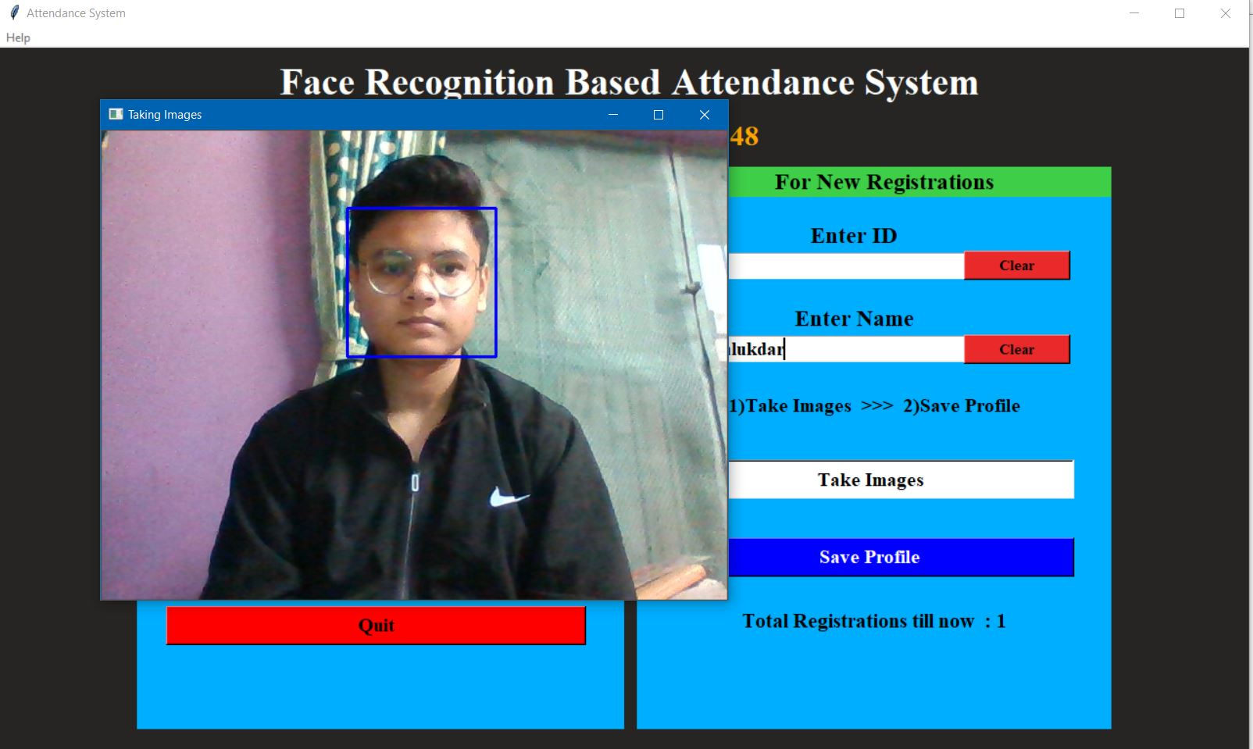
DEMO USING PROJECT(Capturing Image)

Slide 11
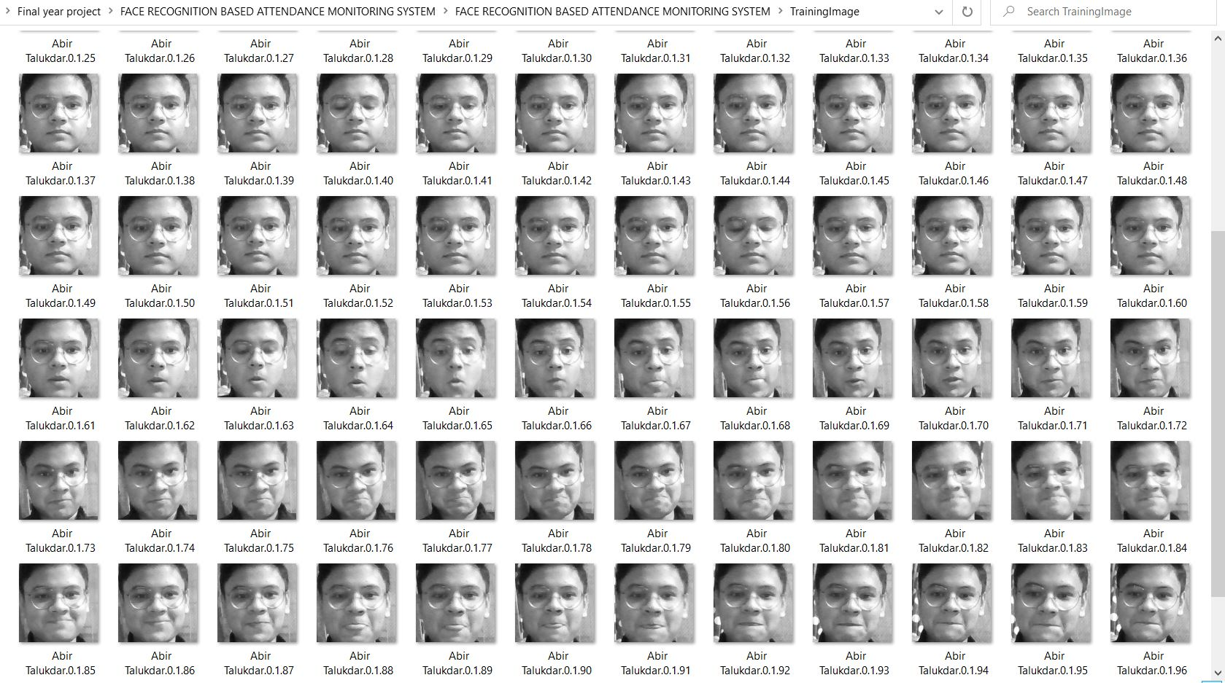
Demo Using Project (Trained Image)

Slide 12
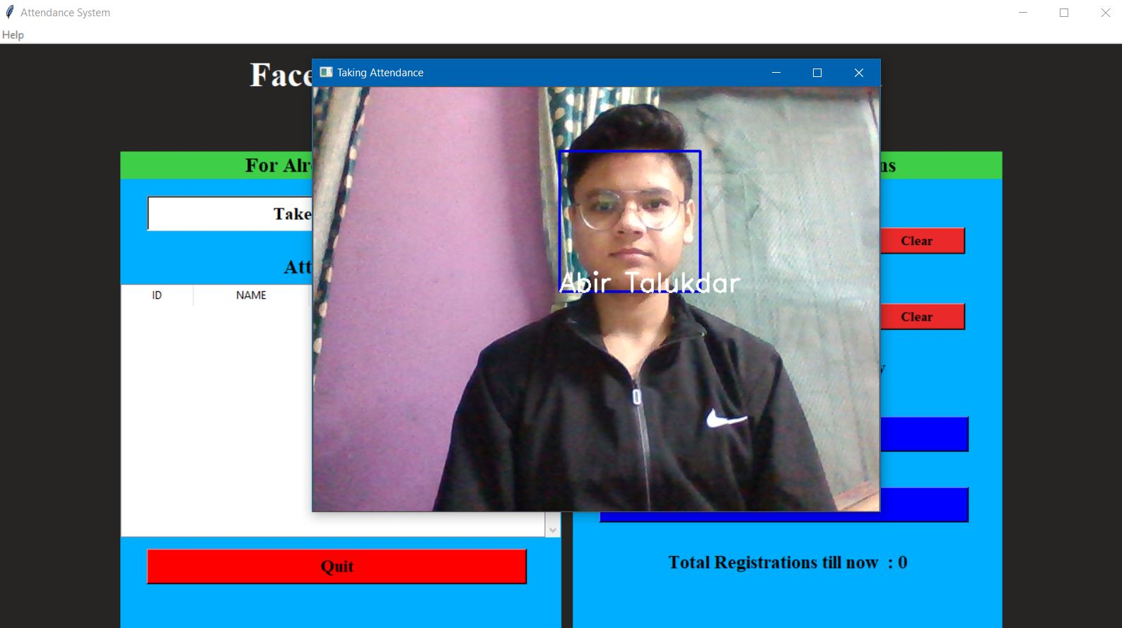
IDENTIFICATION OF TRAINED IMAGES

Slide 13
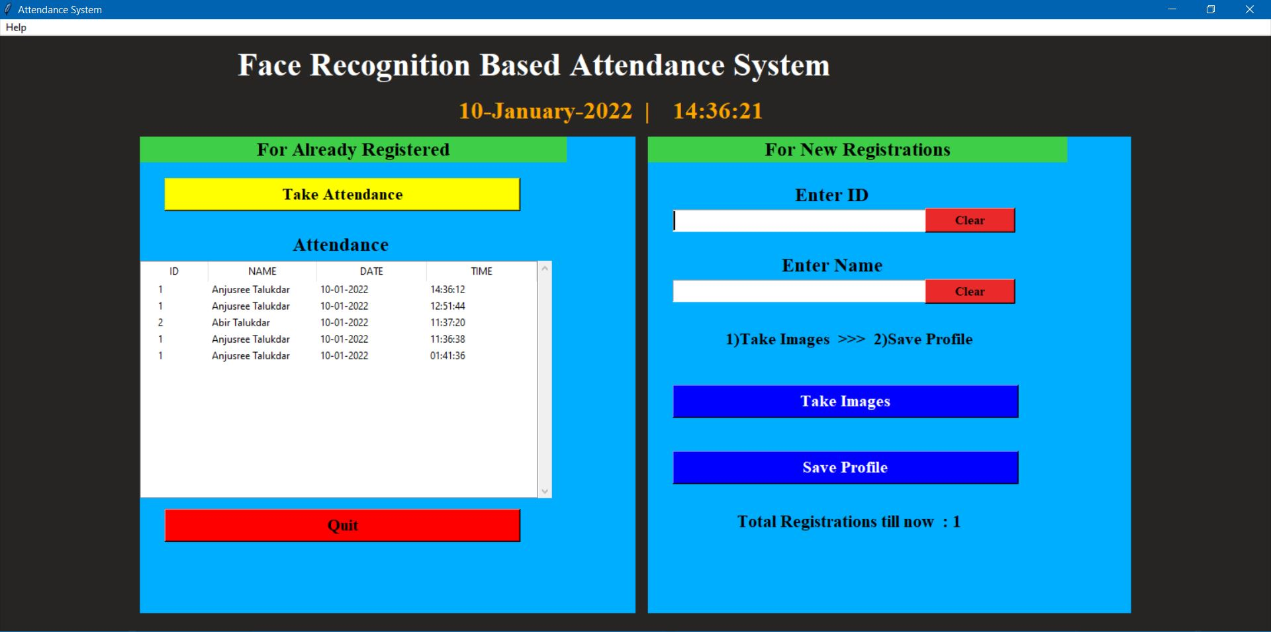
After Identification attendance is marked including date and time
IDENTIFICATION OF TRAINED IMAGES

Slide 14
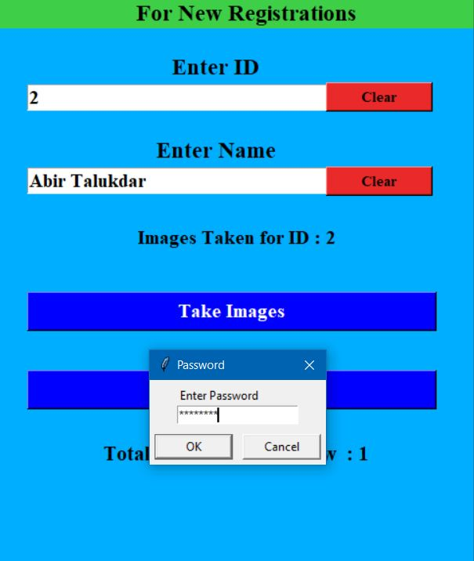
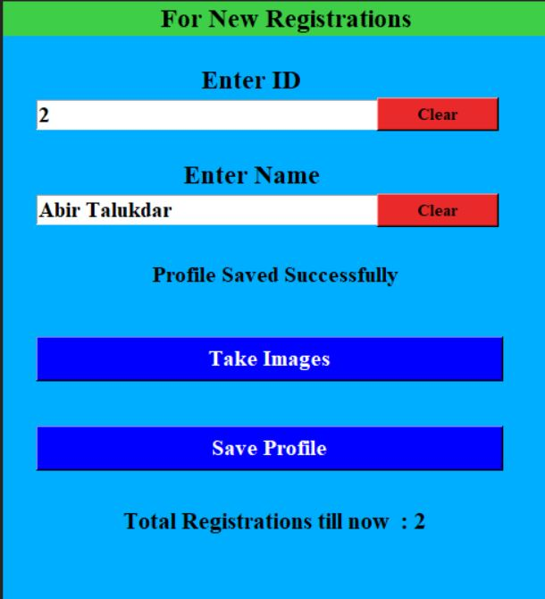
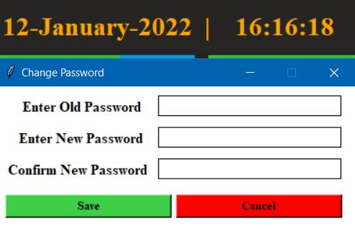


PASSWORD FEATURE
The admins can also reset passwords

Slide 15
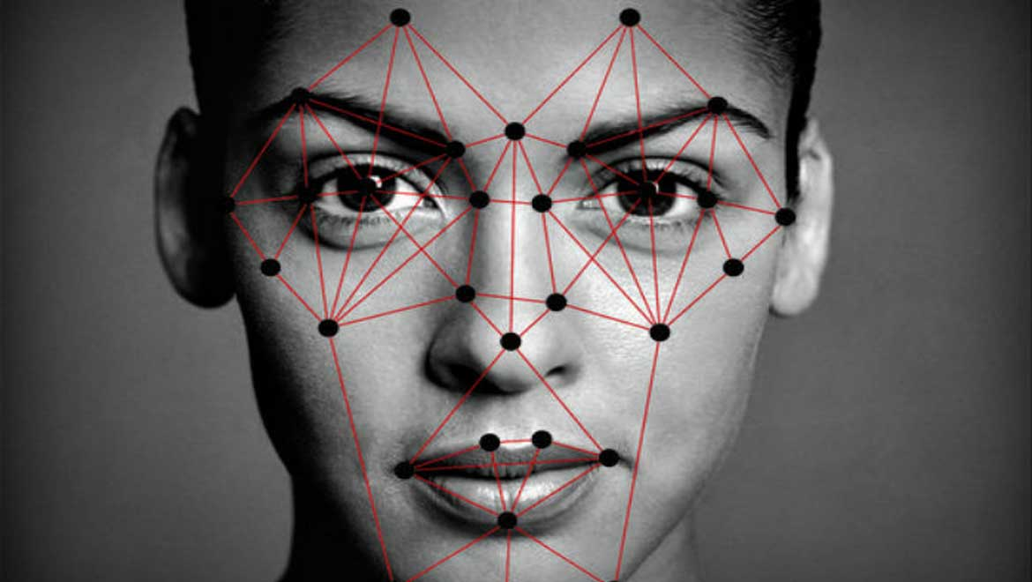
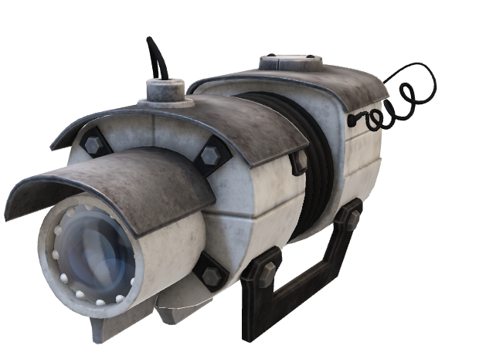
FUTURE SCOPE
Further extensions can be made, to achieve the real time detection of specific student in the surveillance premises. Instead of taking images, we can also work with recorded videos.
The future work is to improve the recognition rate of algorithms when there are unintentional changes in a person like tonsuring head, using scarf and beard.
The system developed only recognizes face up to 30 degrees angle variations which has to be improved further.
Gait recognition can be fused with face recognition systems in order to achieve better performance of the system

Slide 16
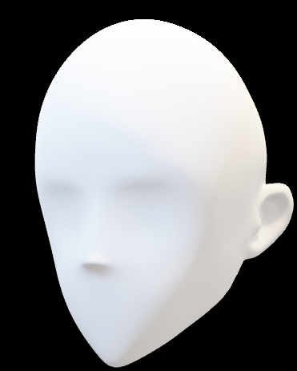
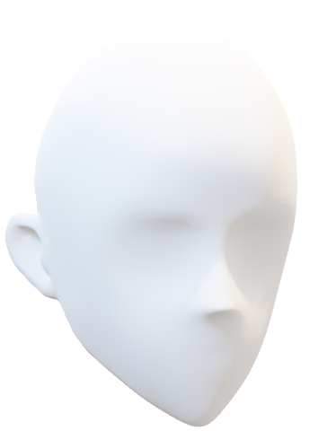
LIMITATIONS
Poor Image Quality Limits Facial Recognition's Effectiveness Image quality affects how well facial-recognition algorithms work.
Small Image Sizes Make Facial Recognition More Difficult.
Different Face Angles Can Throw Off Facial Recognition's Reliability The relative angle of the target's face influences the recognition score profoundly.

Slide 17

CONCLUSION
This system helps to avoid the fail proof of attendance system and this system works as the substitute for the all existing systems i.e. Radio Frequency Identification and all other bio metric systems.
It saves the time and energy in the aspect of taking attendance.
Automated Attendance Systems based on face recognition techniques thus proved be time saving and secured.

Slide 18
REFERENCES
"Attendance System Using NFC Technology with Embedded Camera on Mobile Device" (Bhise, Khichi, Korde, Lokare, 2015)
K.SenthamilSelvi, P.Chitrakala, A.Antony Jenitha, "Face Recognition Based Attendance Marking System", IJCSMC, Vol. 3, Issue. 2, February 2014.
OpenCvDocumentation -https://opencv.org

Slide 19


